Slide 1
Open AI Hackathon
Mentor :- Akash Deep Saxena
Harsh Rai :: Anmol Chopra :: Vaishnavi Singh :: Bharat Shakya
Team
“SENORITA”

Slide 2




Problem Statement :- Use Open AI to create Shell Script from Natural Language.
Challenge Details
Objective
Fetch and import Project from Github
Create a windows cmd utility to accept list of instruction in text file as input
Use Open AI to generate a Power Shell Script based on the instruction in the text file .
Expected Output
Error free Power Shell script.
Open AI Prompt and Settings
Criteria
Quality of code struture
Creativity in Open AI Prompt
Problem Statement
Notes:
Can you please update the slide’s content if necessary?

Slide 3
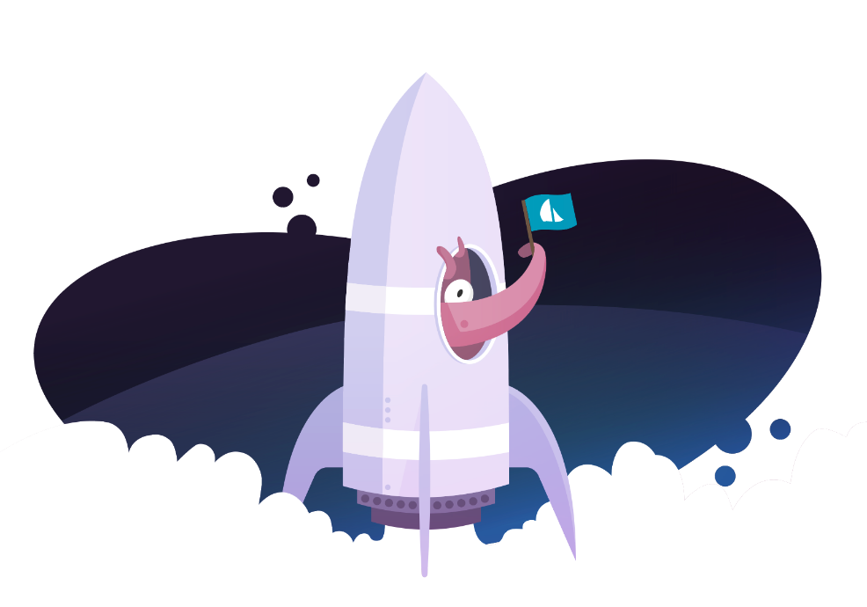



Traditional Way of Execution!
Fetching Repository → Code → Bug Fixing → Generate Test Cases → Test → Deploy
Traditional Way of Execution

Slide 4


How We Executed?
How We Executed?

Slide 5
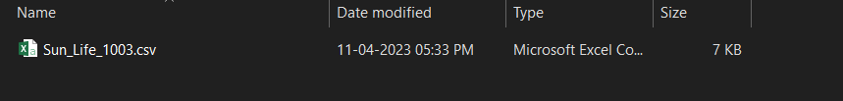
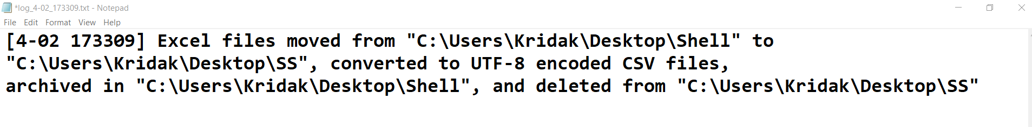
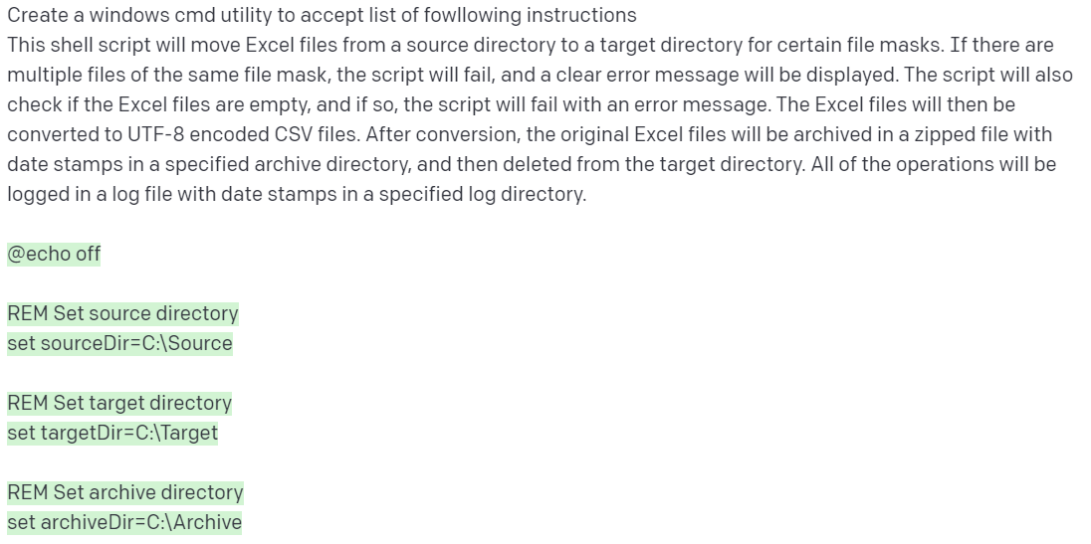
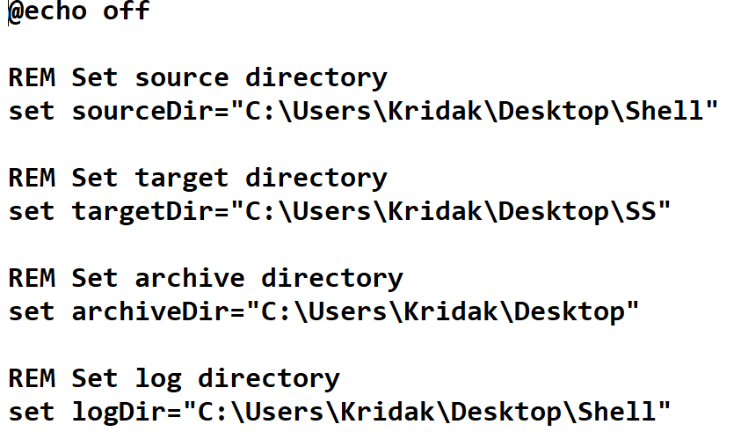
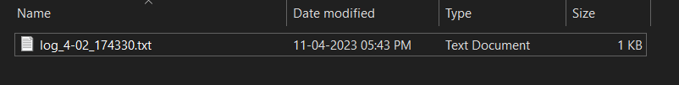

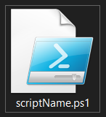
Output
Log Generated
File Moved and Converted to CSV
Prompt
Code Generated By Open AI
Utility
File Removed
Compressed Archive
Output

Slide 6
OpenAI Playground Configurations & Output
Model: text-davinci-003 → Temprature:0.8 → Top P: 0.95 → Frequency penalty: Default → Presence penalty: Default → Maximum length: 2743 → Best of: 3
Move Excel files from source to target directory and convert to UTF-8 encoded CSV files
If multiple files of the same mask, the script fails and an error message is displayed
Check if Excel files are empty and fail with error message if so
Archive original Excel file with date stamp in specified archive directory, then delete from target directory
Log all operations in log file with date stamps in specified log directory
Configurations and Outputs

Slide 7
Technologies
OPEN AI
What is OPEN AI?
OpenAI is a research laboratory focused on developing artificial intelligence (AI) technologies.
What is ChatGPT?
Chat GPT is a natural language processing (NLP) technique that uses a generative pre-trained transformer (GPT) model to generate responses to user input.
What is Open AI Playground?
Open AI Playground is an online platform that allows users to experiment with and explore the capabilities of OpenAI's artificial intelligence (AI) technologies
Intro To Technologies

Slide 8
Learnings
Strategy :- Time Quantum.
Planning
Creating Best Possible Outcome
How to work with new technologies such as Open AI
Learnings

Slide 9
Challenges
Open AI playground gets timeout after every 10 seconds, so we need to press enter again and again for the full output.
Open AI limits the amount of time and a single user id cannot operate on different systems.
Open AI generates different results in same case statements.
Open AI playground didn’t generate the whole solution in one go, so we had to finalize a way to give it an appropriate prompt to generate the whole solution in one go.
Limitation of Maximum Length.
Challenges during Performance

Slide 10
THANK YOU

